Slide 1
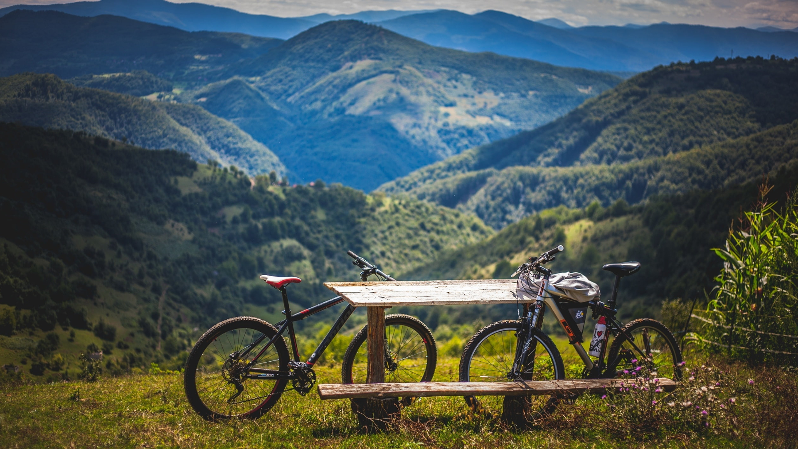
Bike Renting Demand Prediction
Presented by: Sachinkumar Jadav

Slide 2




Sachinkumar Jadav
Aspiring Data Scientist
Education
Skills
Contact
M.Sc. Mathematics(2019-2021) from Sardar Patel University
B.Sc. Mathematics(2016-2019) from Gujarat University
HSC Science(2016), Bits School of Science
SSC(2014) , St. Xavier’s High School
Pune, Maharashtra
Python
Statistics
SQL
+8141240925
Pandas
Excel
sgkjadav@gmail.com
Hobbies
Languages
English
Sketch
Music
Anime
Gaming
Gujarati
Hindi

Slide 3
Problem Statement:
Currently Rental bikes are introduced in many urban cities for the enhancement of mobility comfort
The client is Seoul Bike, which participates in a bike share program in Seoul. An accurate prediction of bike count is critical to the success of the Seoul bike share program
The final aim of this project is the prediction of bike count required at each hour for the stable supply of rental bikes

Slide 4
Work Flow:
Data Collection
and
Understanding
Data Wrangling & Feature Engineering
Conclusions
EDA
Model Selection and Evaluation
Preparation of data for model building.
05

Slide 5
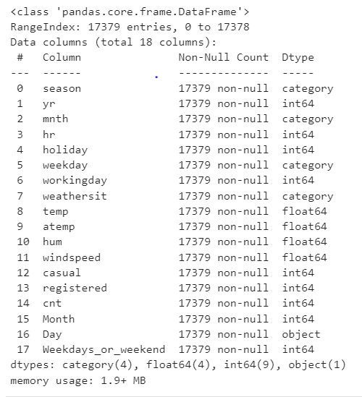
Data Features:
Bike Data is used for Analysis and Model Building
The dataset contains weather information (Temperature, Humidity, Wind speed), the number of bikes rented per hour and date information
In this we had total 17379 observations and 18 features including target variable

Slide 6
Data Wrangling and Feature Engineering:
As we know we had 17379 observations and 18 features.
Categorical Features: Seasons, Holiday, month, weekday and Day
Numerical Columns: Date, Hour, Temperature, Humidity, Wind speed, Rented Bike count
The Dataset has no null values
Zero Duplicate entries found
Changed the data type of Date column from ‘object’ to ‘datetime64[ns]’ for feature engineering
Created two new columns with the help of Date column ‘Month’ and ‘Day’ for used in EDA
Dropped Date column

Slide 7
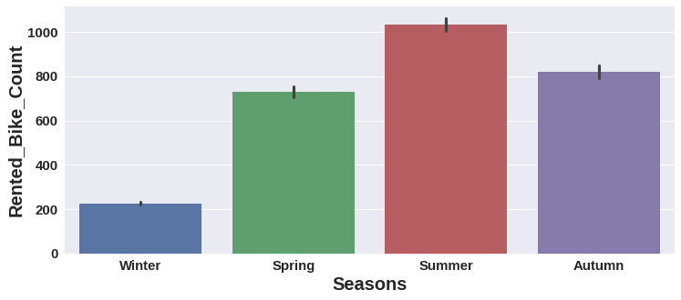
EDA (Exploratory Data Analysis)
-
Summer season had the highest Bike Rent Count

Slide 8
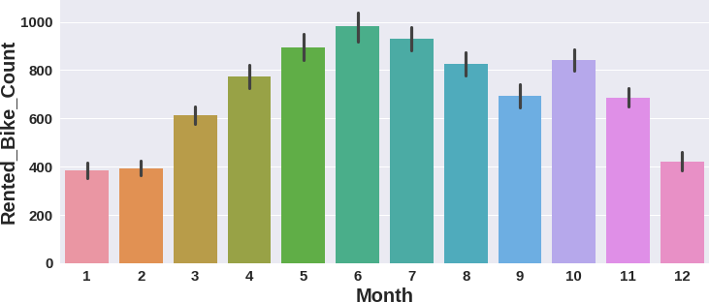
EDA (Exploratory Data Analysis)
Bike Rent Count started since March and it was highest in June.

Slide 9
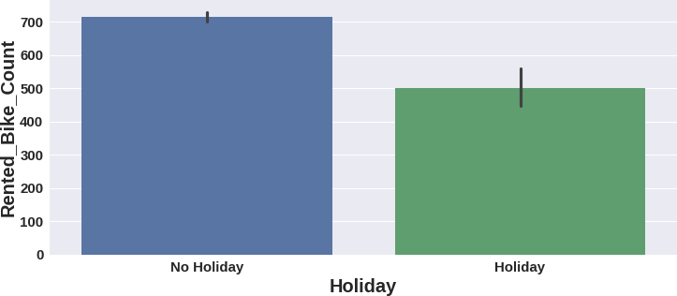
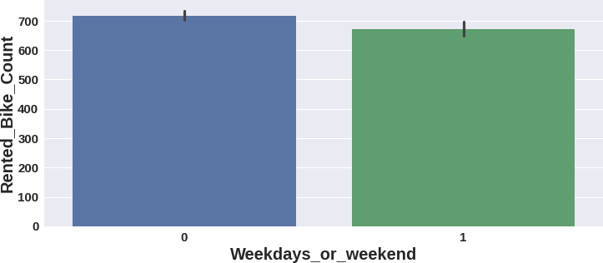
EDA (Exploratory Data Analysis)
High number of bikes were rented on No Holidays.
Which is almost 700 bikes.
More than 700 bikes were rented on weekdays.
On weekdays, almost 650 bikes were rented.

Slide 10
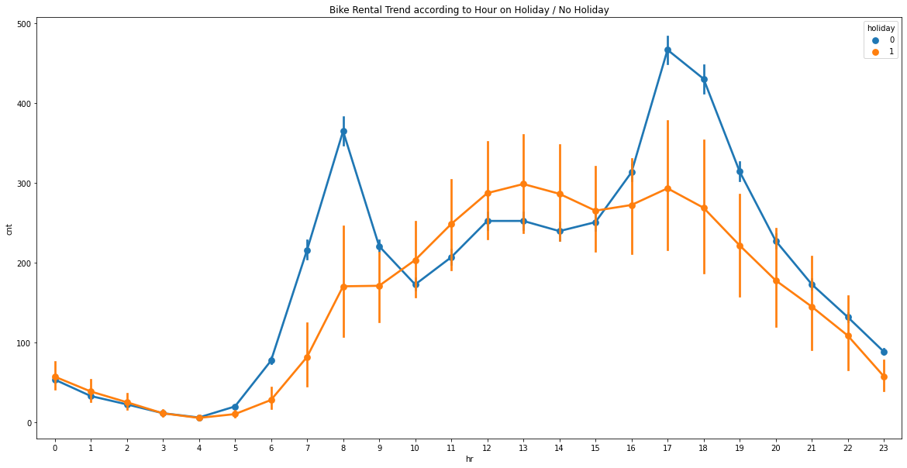
EDA (Exploratory Data Analysis) : Observation
Count
Hour

Slide 11
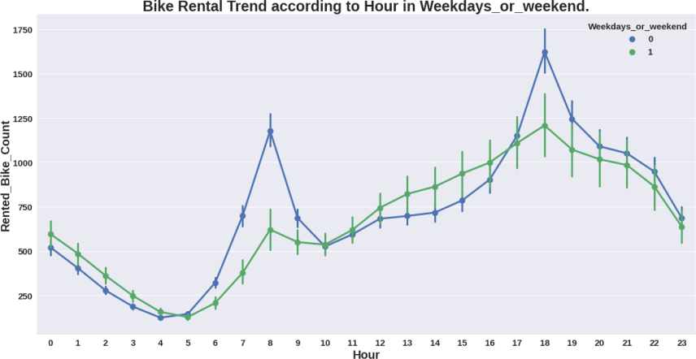
EDA (Exploratory Data Analysis) : Observation

Slide 12
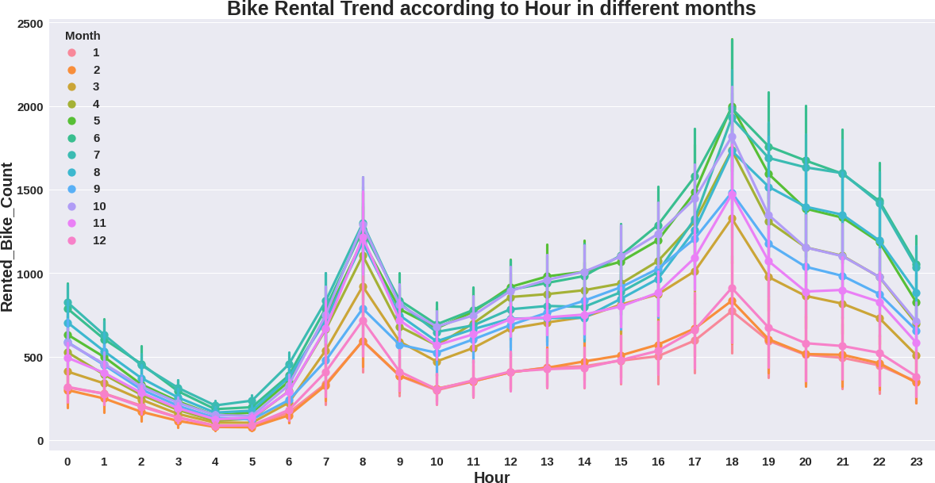
EDA (Exploratory Data Analysis) : Observation

Slide 13
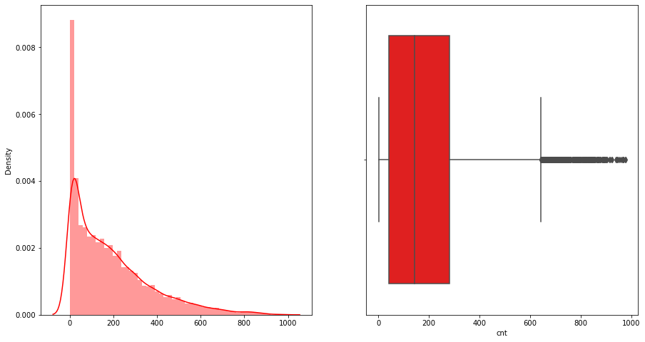
EDA (Exploratory Data Analysis) : Observation
Rental Bike
Rental Bike

Slide 14
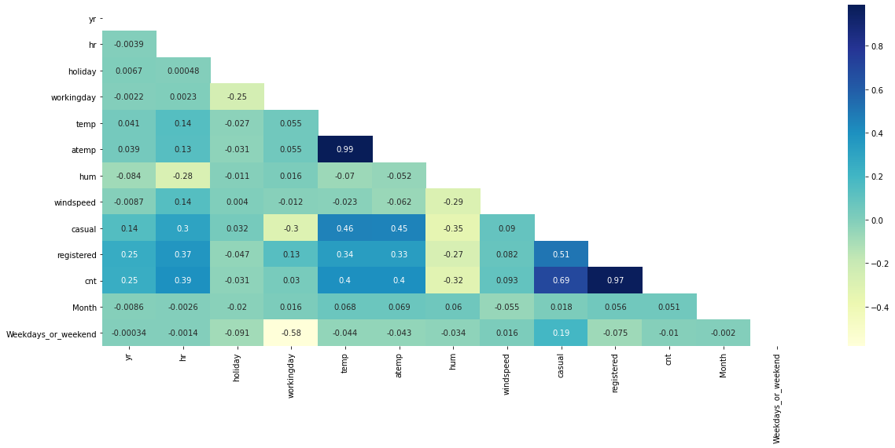
Preparation of Data for Model Building
Next I created dummy variables for categorical Seasons column and did mapping with 0 and 1 for holiday and functioning column.

Slide 15
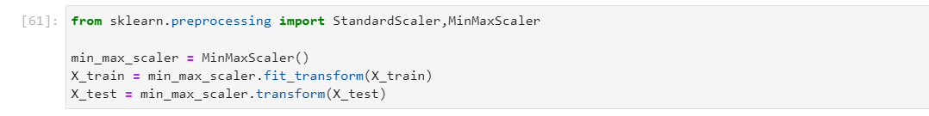
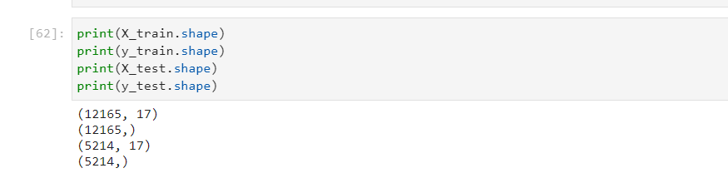
Data Standardization
Data standardization helps improve the quality of your data by transforming and standardizing it

Slide 16
Model Selection and Evaluation
As this is the regression problem we are trying to predict continuous value. For this we used following regression models.
Single and Multiple Linear Regression
Lasso regression (regularized regression)
Ridge Regression(regularized regression)
ElasticNet Regression(regularized regression)
Decision Tree Regression
Random forest Regression
AdaBoostRegressor
Gradient Boosting Regression
Xtreme Gradient Boosting Regression

Slide 17
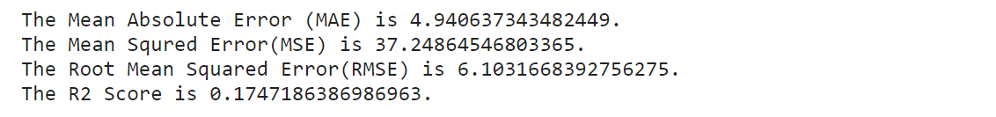
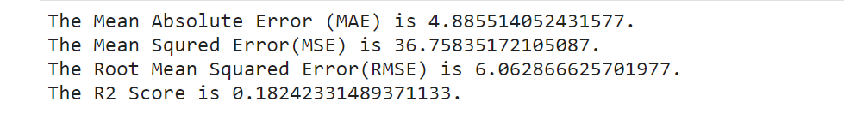
Model Selection and Evaluation
Single Linear Regression:
Train Set:-
Test Set:-
Linear regression analysis is used to predict the value of a variable based on the value of another variable.

Slide 18
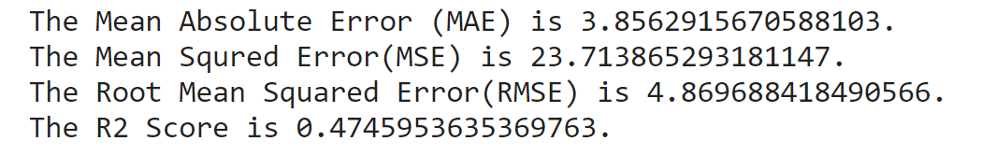
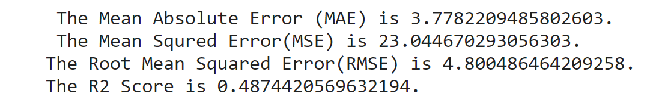
Model Selection and Evaluation
Multiple Linear Regression:
Train Set:-
Test Set:-
Linear regression analysis is used to predict the value of a variable based on the value of another variable.

Slide 19
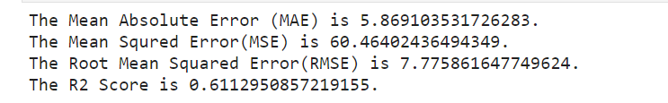
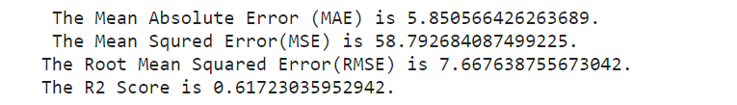
Model Selection and Evaluation
Lasso Regression:
Train Set:-
Test Set:-
Lasso regression analysis is used to predict the value of a variable based on the value of another variable.

Slide 20
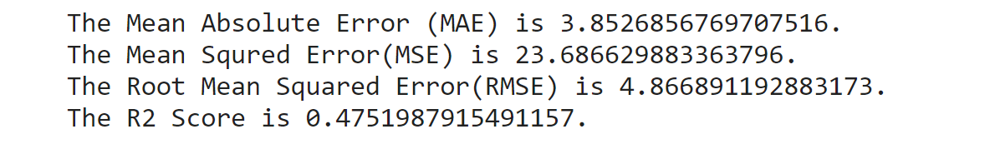
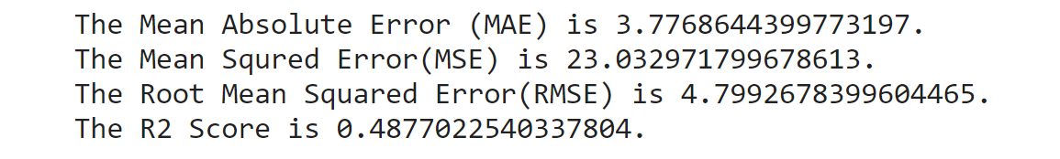
Model Selection and Evaluation
Ridge Regression:
Train Set:-
Test Set:-
Ridge regression is a model tuning method that is used to analyze any data that suffers from multicollinearity.

Slide 21
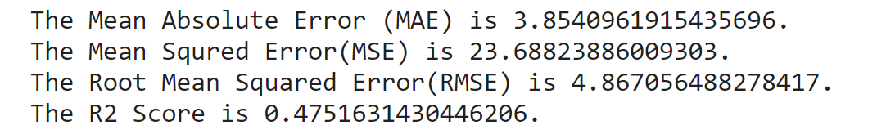
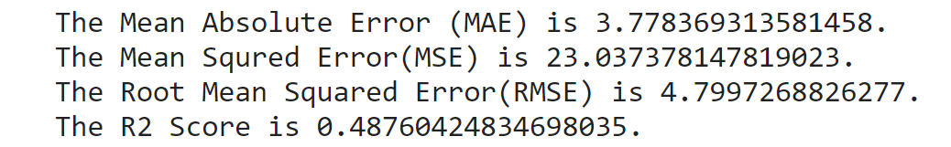
Model Selection and Evaluation
ElasticNet Regression:
Train Set:-
Test Set:-
Elastic net linear regression uses the penalties from both the lasso and ridge techniques to regularize regression models.

Slide 22
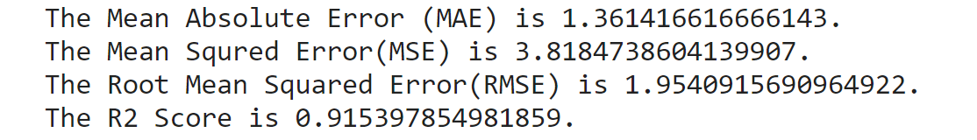
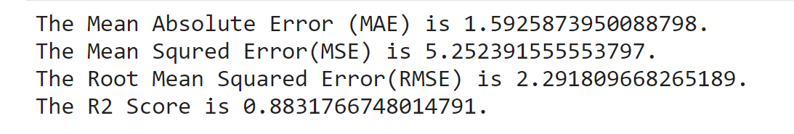
Model Selection and Evaluation
Decision Tree Regression:
Train Set:-
Test Set:-
Decision tree regression observes features of an object and trains a model in the structure of a tree to predict data in the future to produce meaningful continuous output.

Slide 23
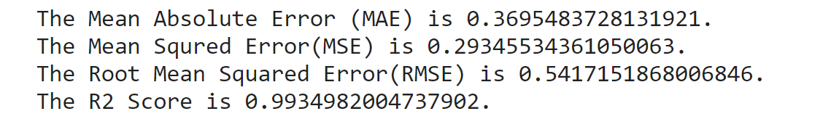
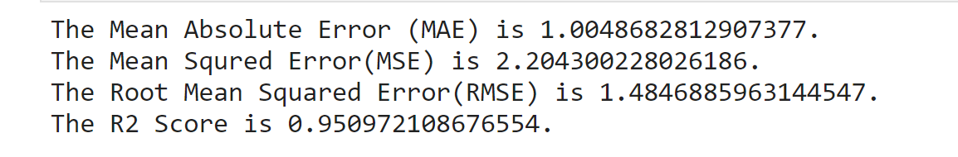
Model Selection and Evaluation
Random Forest Tree Regression:
Train Set:-
Test Set:-
Random forest is a type of supervised learning algorithm that uses ensemble methods (bagging) to solve both regression and classification problems.

Slide 24
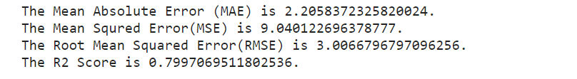
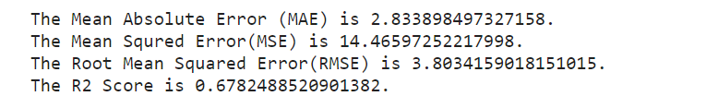
Model Selection and Evaluation
K Nearest Neighbor Regression:
Train Set:-
Test Set:-
KNN is a type of supervised learning algorithm that uses distance methods to solve both regression and classification problems.

Slide 25
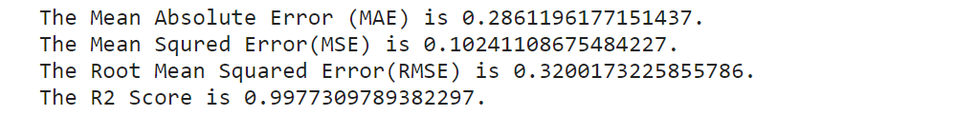
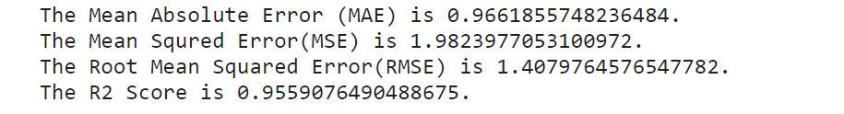
Model Selection and Evaluation
AdaBoostRegressor:
Train Set:-
Test Set:-
An AdaBoost regressor algorithm helps to convert weak learners to strong learners. It combines Several best model in order to produce best generalize model.

Slide 26
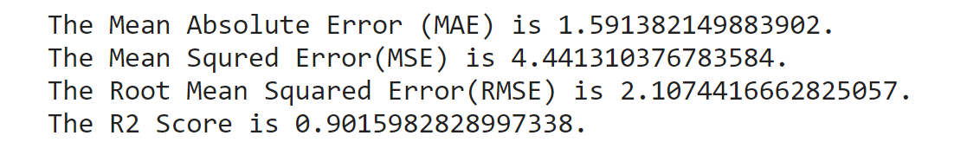
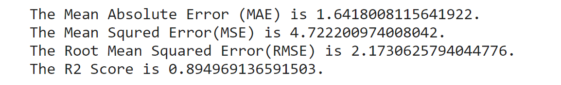
Model Selection and Evaluation
Gradient Boosting Regression:
Train Set:-
Test Set:-
Similar to finding the line of best fit in linear regression, the goal of gradient descent is to minimize the cost function, or the error between predicted and actual values.

Slide 27
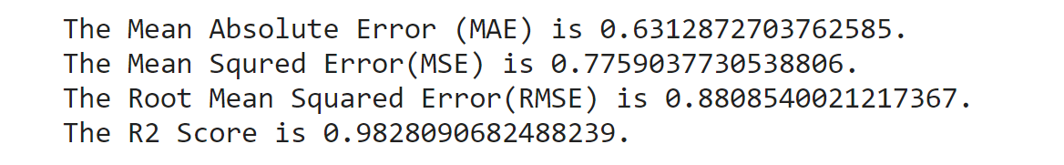
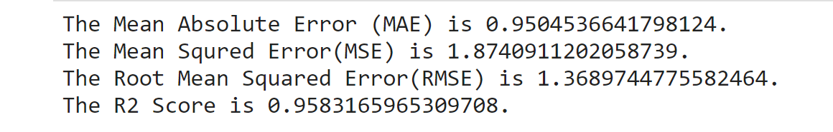
Model Selection and Evaluation
Xtreme-Gradient-Boosting Regression:
Train Set:-
Test Set:-
Extreme Gradient Boosting is a tree-based algorithm, which suits under the supervised branch of Machine Learning.

Slide 28
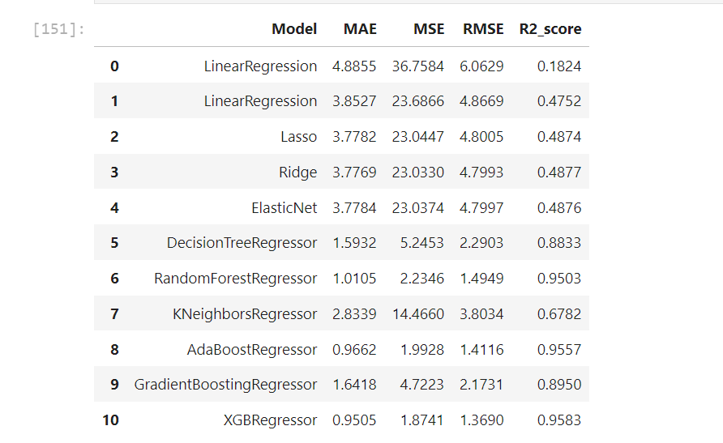
Result:

Slide 29
Conclusion:
As per our analysis Extreme Gradient Boost Algorithm gives highest accuracy as compared to other Algorithm
From this we can predict bike count required at each hour and season for the stable supply of rental bikes.

Slide 30
Thank You.

